Slide 1



Team Oceanus
Critical Design Review

Slide 2
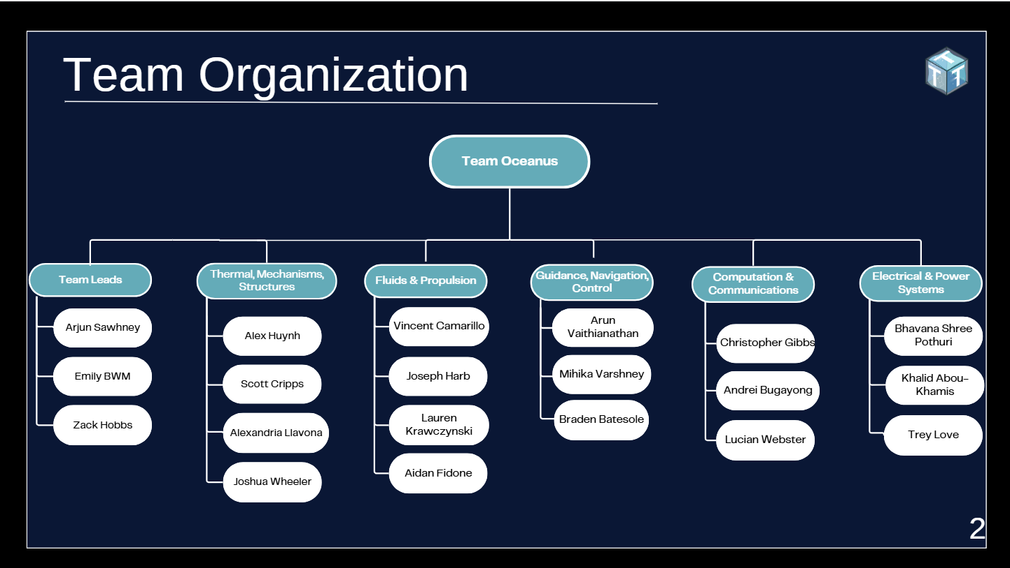
Team Organization
2

Slide 3
Mission Statement
The mission of Team Oceanus is to support scientific research, environmental monitoring, and offshore energy infrastructure operations through the creation and operations of an underwater ROV capable of precise navigation, controlled manipulation, dynamic stability, and structural robustness, while complying with the electrical, mechanical, and safety requirements established by MATE.
4

Slide 4
Mission Objectives
Primary Objectives: The ROV must successfully complete all required MATE ROV 2026 product demonstration tasks.
Collect species from the coral garden
Service the Holyrood subsea observatory
Powering an oil platform from a wind turbine
Floats Under the Ice
Secondary Objectives: The ROV must ensure safe, reliable and compliant operation during all mission runs.
4
Notes:
Primary objective number 4 is not required task to show in the video demonstration, however, it should still be a primary objective since it is a assigned task for worlds!

Slide 5
Success Criteria
The ROV must complete all primary tasks required to qualify for Worlds within the 15 minutes of the video demonstration.
The ROV must follow all the rules noted in the Product Demonstration notes during the demonstration video.
The ROV must collect at least one basket star and one coral species during the video demonstration.
All electrical, mechanical, and fluid power subsystems must comply with MATE specifications.
4

Slide 6
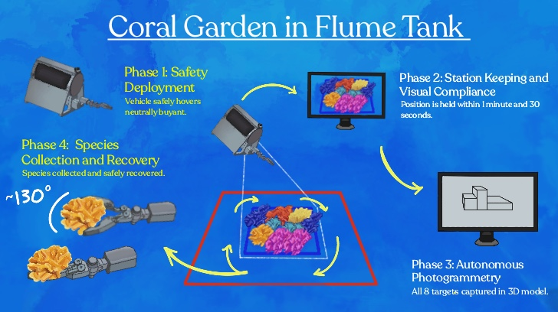
4
Notes:
MATE ROV provided us 4 different tasks. Some of them will take place in different environments which will be specified in the name that we give the tasks.
We call Task 1 Coral Garden in Flume Tank.
In Phase 1, the ROV descends to the coral garden while team Oceanus confirms camera visibility and establishes awareness of the ROV’s location.
In Phase 2, the ROV maintains position over the coral garden under a current, this while creating a video of the site. The ROV must be able to maintain stable motion and collect video of the coral garden without the visibility of the red pipes.
If the video shows these red pipes or is unable to show the blue pipes, it will invalidate that attemp.
In Phase 3, Our approach will be autonomous photogrammetry, where the ROV surveys around the garden to collect images and create a scaled 3D model of the coral garden.
If we are unable to make a rotable 3D model, we won’t get any points
In phase 4, the ROV does biological sampling. We are tasked to collect two of each of the species by the substrate only within the garden without damaging the coral.
If we collect these species not by the substrate, we will get half the points for them.

Slide 7
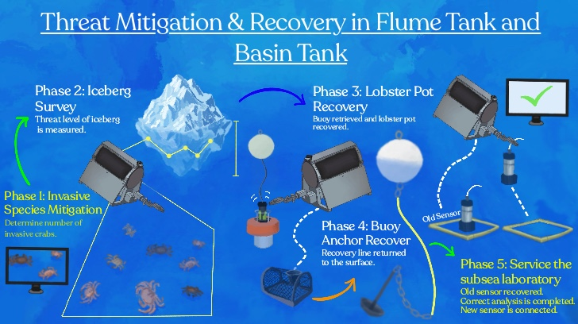
4
Notes:
Task 2 is called Threat Mitigation & Recovery, Phase 1 and 2 will take place in the flume tank while phases 3 to 5 will take place in the Basin tank.
In Phase 1, the ROV will determine the number of invasive European green cards within the sample area. This through image recognition.
Only one attempt is allowed for this phase.
Incorrect count of crabs will result in zero points
Once the count is done, the data will be uploaded to the Invasive Species Form
In phase 2, the ROV will survey an iceberg at 5 different locations to measure the its keel depth. By using the icebergs location and keel depth, we will determine the threat level of this iceberg.
ROV can survey less than 5 different locations but that will result in less points.
In Phase 3, the ROV will simulate an acoustic release of whale fishing gear by turning a handle as seen in the image. Once the gear is released, the lobster pot will be recovered by the ROV and returned to the surface at the side of the pool.
The acoustic release must be done before the lobster pot or we wont get any points for this acoustic release.
In phase 4, the ROV will attach a recovery line to the buoy anchor and return the line to the surface.
Reattempts for this task is permitted.
In phase 5, the ROV will recover the old eDNA biosensor to the surface. Its data will be analized to derminte the frequency of detected organisms. Then the ROV will install a new sensor. Finally the ROV will rotate the inner plastic sheet of the observatory camera, motion required to clean this camera.
Reattempts are allowed for this phase. Sensor tipping or leaving the area will reduce our score.

Slide 8
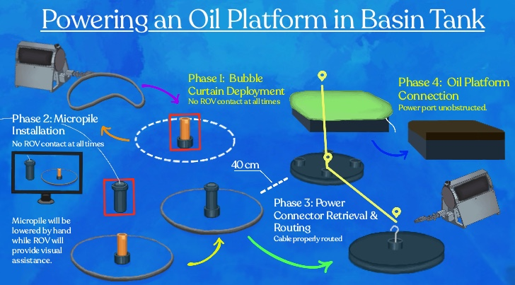
4
Notes:
Task 3 is called Powering an Oil Platform in the Basin Tank.
In Phase 1, the ROV will deploy a bubble curtain around the micropile location. To succeed, the ROV must not have contact with the micropile location.
In Phase 2, the ROV will provide visual guidance to team Oceanus to manually lower the micropile and install it. Once again, the ROV cannot be in contact with the micropile. Once the micropile is installed, the ROV will remove the pin that connect the micropile to the string.
In Phase 3, the ROV will route the cable of the wind farm along the floor. The cable must be laid through a waypoint near the micropile.
In Phase 4, the ROV will remove the protective cover from the oil platform port and install the power connector.

Slide 9
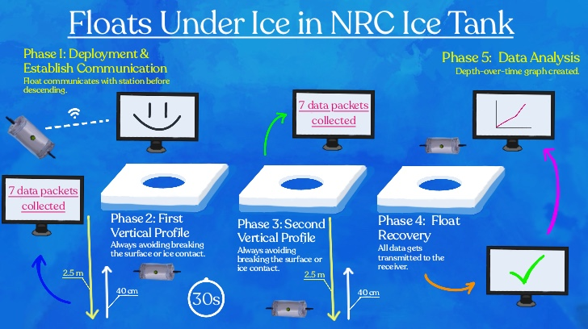
4
Notes:
Task 4 is called Floats under icea, which will take place in an ice tank.
In phase 1, the float must establish communication with the station before entering the water. The float will transmit an initial data packet.
In phase 2, the first vertical profile will take place. The float will autonomously descend to a target depth of 2.5 meters and hold its depth for 30 seconds while collecting data. Then the float wil ascend to 40 cm below ice and hold for 30 seconds. In order to be done with this phase, the float must have collected 7 data packets.
In phase 3, the second vertical profile will take place. The float will again descend, hold its depth, ascend and hold again. This while collecting data. In order to be done with this phase, the float must collect 7 data packets.
In phase 4, the float is recovered from the water by a ROV operated by the competition. The data from the float will get transmitted to the receiver.
In phase 5, the float will transit its data to the mission station to create a depth over time graph.

Slide 10

Thermals, Mechanisms, Structures (TMS)

Slide 11
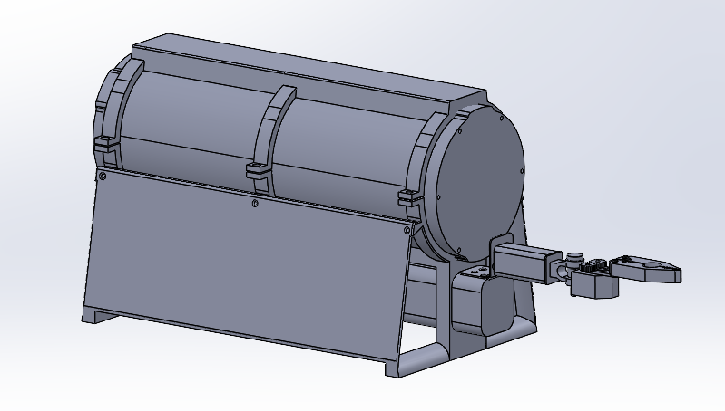
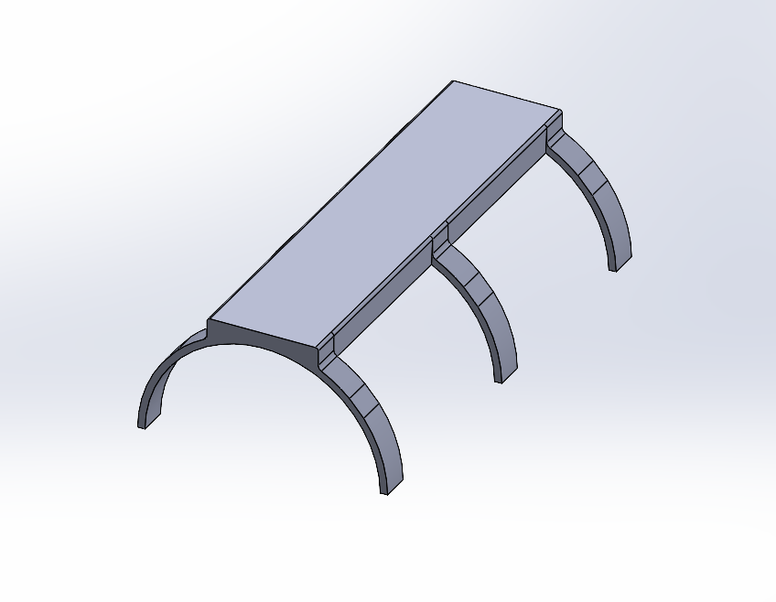
Chassis
PETG Frame
Three-Ring Structure
Trapezoidal Design
Structural Integrity
8
Notes:
Speaker notes:
The chassis is built around a modular frame made from PETG. The electronics enclosure is 300 mm, made out of aluminum, equipped with o-ring flanges and end caps to create a waterproof container. The frame is composed of three rings, which are each separated into two half rings, which are fastened together at two tabs. This was to consider accessibility to the electronics enclosure (half rings) while still focusing forces towards the core cylinder of the ROV. The front of the ROV has an extension for the manipulator’s hinge, which is to prevent the arm from making contact with the ROV. The front and back interfaces are filleted at the leading edges to reduce drag, and have an open structure to reduce wake strength. The side frames however, do not include holes to make for more predictable shedding over cavity vortices.

Slide 12
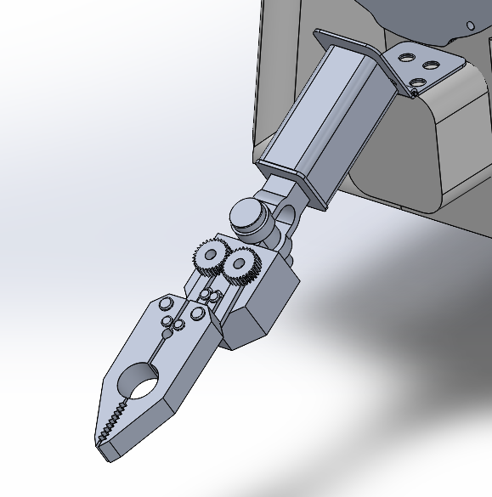
Claw
Hinge
Different holes with rubber interior
Hardstop and reinforcement
Wrist Joint
8
Notes:
Speaker notes:
Hinge will be able to rotate 90 degrees upward and 180 degrees downwards in order to be able to lift certain objects out of the pool and to be able to accommodate for one of the tasks. Reinforcement will be placed on the hinge alongside a hardstop and a program to stop the gears from overworking. However, this mechanism is not as worrying as it would be above water due to water relieving some of that strain. Handling would just have to be very careful and mindful that above water. Additionally, the claw has two different holes, one to account for the PPC pipe structures and the other to grab a pin (with the small hole being farther out so it is easier for the driver to grab it. The interior would be made out of a specific rubber that is made for underwater handling (Neoprene or EDTM). Wrist joint would be able to allow the front half of the mechanism to go side to side. Some parts of the mechanism will be 3d printed and other parts made during manufacturing.

Slide 13
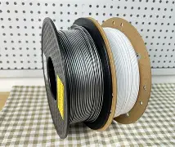
Material/Design Justification
PETPET
Material Chosen: PETG
Repairability/Manufacturability
Rapid Repairs/Iterations
Safety
Material/Manufacturability
Chemical Physical Deformation
Cheap Coating/Geometries/Shallow Water Operation
Integration and System Compatibility
Manufacturability
6
Notes:
PETG was selected as the primary structural material for the ROV due to its manufacturability and repairability. PETG passes all the environmental screening with corrosion resistance, minimum temperature, and with its quick manufacturability it allows for great iterative development and prototyping at a low cost.
Integration and System Compatibility
Requirements:
The ROV frame must contain at least 1 point of attachment for each required accessory.
The ROV must have 5 independently removable subsystems.
PETG has very straightforward integration with easily manufacturable (3D printing) embedded channels and mounting bosses, which reduces part count and fastener complexity. It is also easily threadable, no galvanic corrosion, and bonding which allows for thrusters, the enclosure, and floatation elements,
Safety
Requirements:
The ROV must use 0 conductive materials near open electronics.
The ROV must use 0 toxic materials for all surfaces handled by team members.
All materials must be skin-safe for all surfaces handled by team members.
The ROV must have 0 sharp edges.
PETG can be manufactured with all sharp edges fileted, avoiding any sharp edges. Not only that, it is also non toxic and skin safe, meeting those requirements. Finally, it provides inherent insulation, reducing the hazards associated with electricity.
Chemical/Physical Deformation
Requirements:
The float materials must experience 0 physical or chemical changes in saltwater or salt brine pool environments for the length of the project timeline.
All external materials must be rated to a depth of at least 7 meters.
PETG can be easily coated to ensure chemical resistance to saltwater. It does not corrode and faces no galvanic degradation. Over the duration of testing/competition, the ROV will operate in shallow-water conditions and will not experience plastic deformation when the geometries are designed well enough, and can be met through proper design, rather than a reliance on material alone.
Repairability and Manufacturability
Requirements:
All wear items must have at least 1 spare.
Repairability and Manufacturability are critical due to the testing environment and development process. As a first time team with little to none experience, making rapid repairs and iterations are essential which make PETG a perfect candidate.

Slide 14
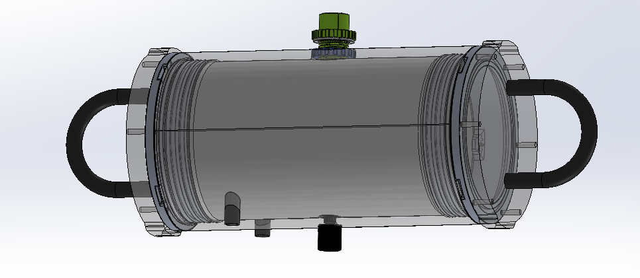
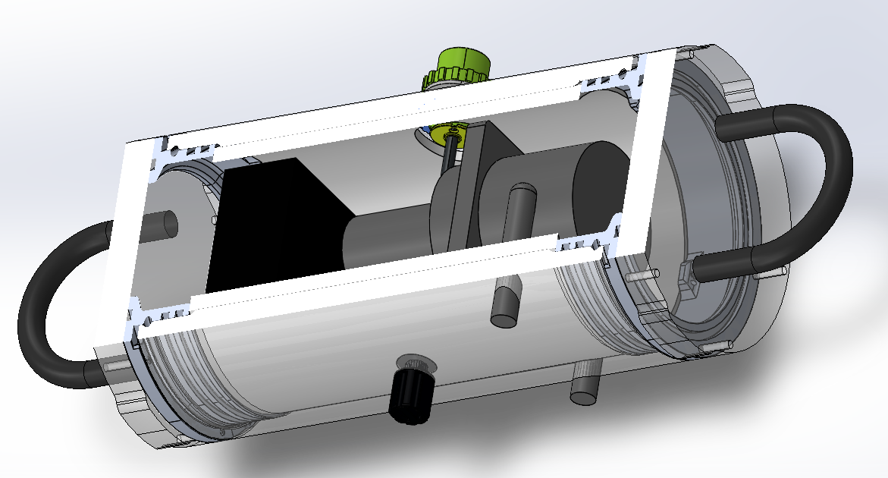
Float
Modified cast acrylic enclosure
Sensor, ballast holes, and rubber stopper
Recovery features
100mm ID 200mm IL
Loctite Marine Epoxy
Thermal regulation (Appendix C)
4mm foam
5 W silicon heating pad
Thermistors
9 C internal temp.
System Buoyancy
1.374 kg
1.060 g/cm^3 density
~neutrally buoyant
9
Notes:
Structure notes:
TMS-specific features include the modified cast acrylic housing (holes for sensors/ballast pump), PETG recovery rings (required by rules 5cm internal width and 5cm internal height), buoyancy/insulating foam (4mm inside to increase buoyancy and insulate hull), heating pad and thermistors (5 Watts to maintain 9 C and thermistors to indicate the need for an emergency shut-off if temp gets too high), pressure release (all you, could CAD this real quick tmrw if you have specifics by then)
*hull modifications will be sealed/adhered using Loctite Marine Epoxy for its cured operating temperature range*
CAD displayed is missing the bladder for the buoyancy system, say that it will be discussed by F&P and when it gets to them Vincent will talk about how a bladder connects to the pump valves (2 grey things protruding from the bottom).
Structure is designed to be neutrally buoyant (water solution has a higher density than regular water), and adding foam and/or weights to dial in buoyancy will be feasible as needed.

Slide 15
Fluids & Propulsion (F&P)

Slide 16
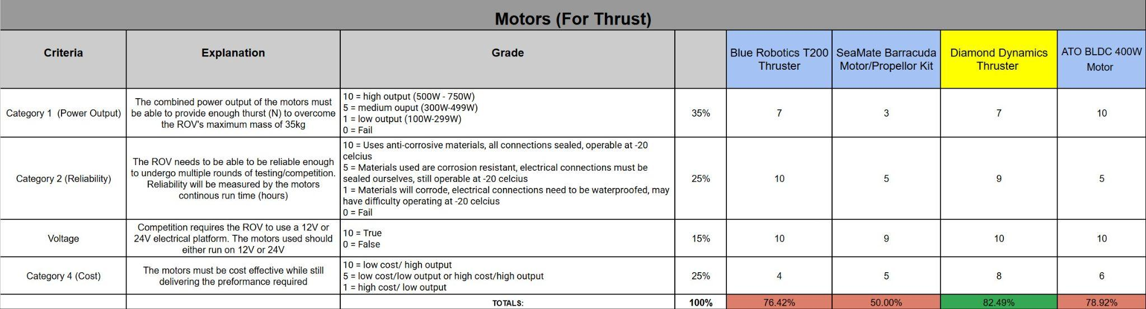
Thruster Trade Study
17

Slide 17
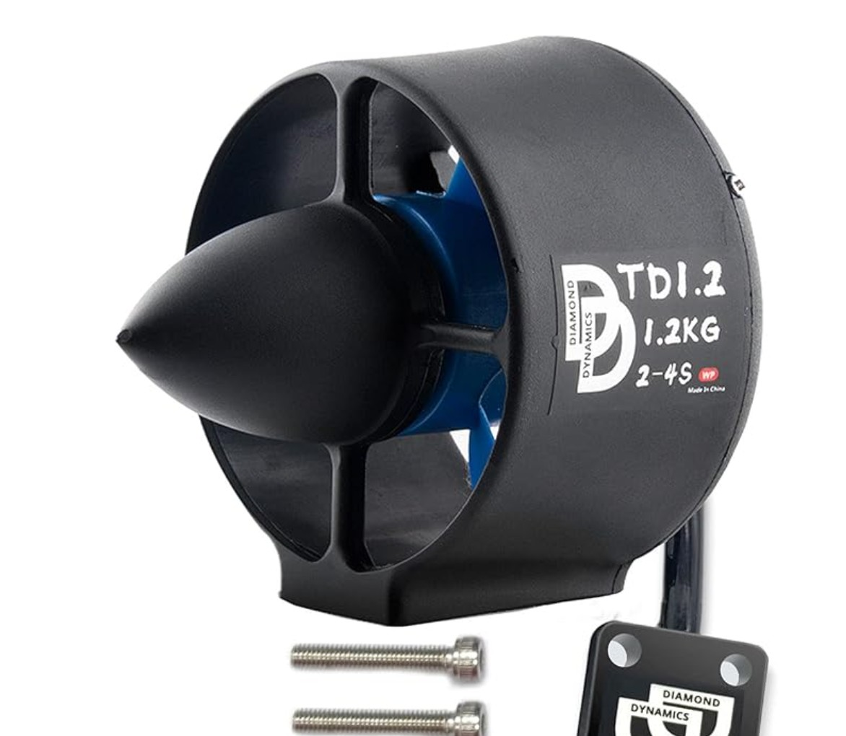
Diamond Dynamics Thruster
Affordable
Sufficient Power
Similar to T200
Still Customizable
18

Slide 18
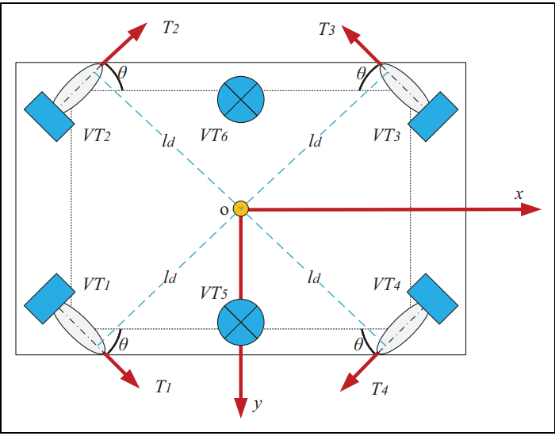
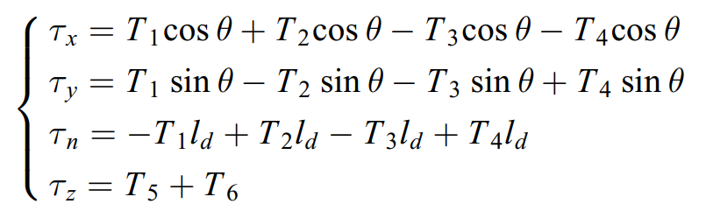
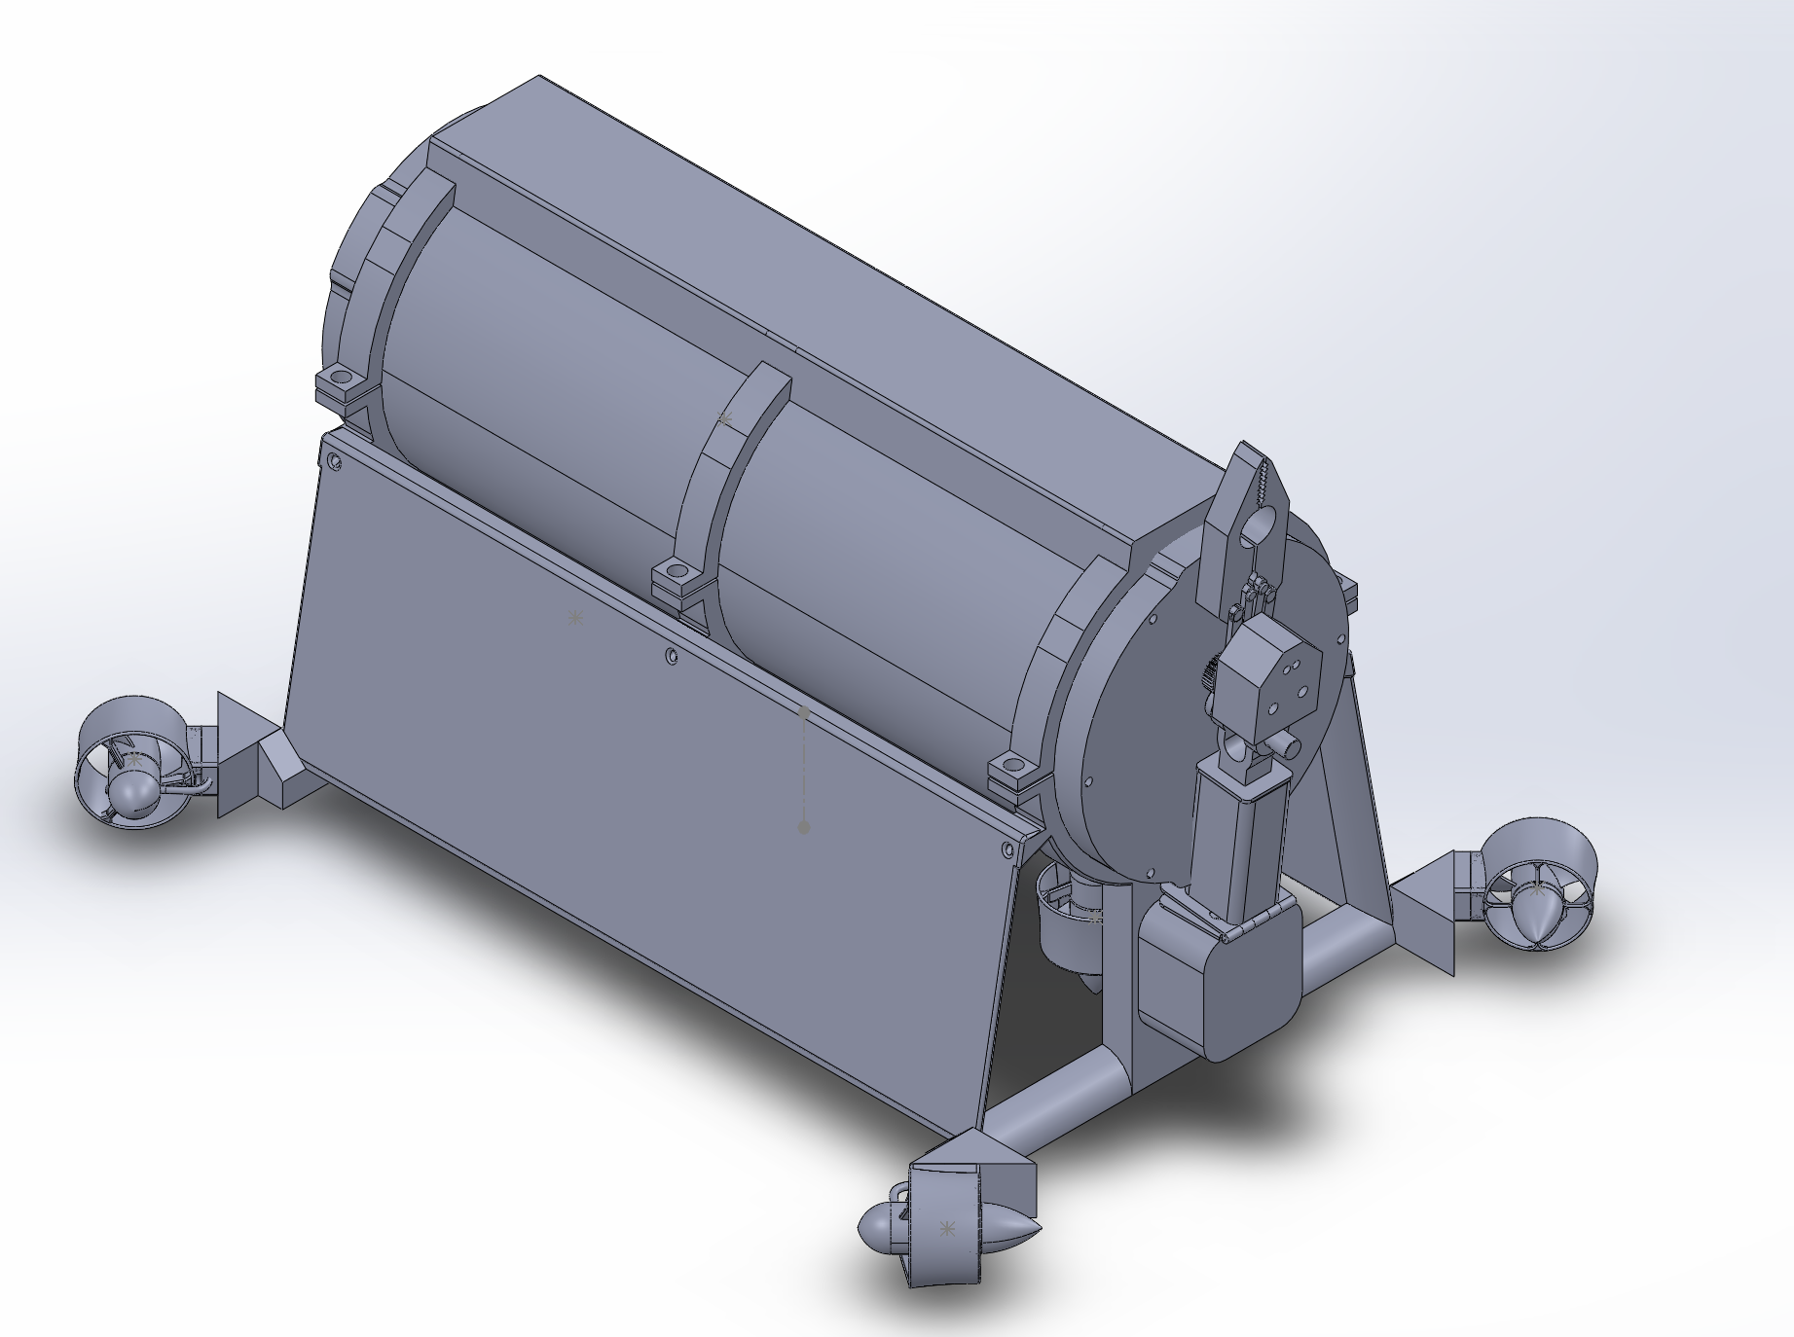
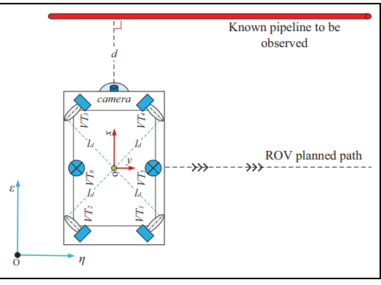
Thruster Configuration
Thrust Allocation for Flight Controls
5 DOF
19
Notes:
The current thruster configuration provides 5 degrees of freedom.
The horizontal thrusters (VT1-4) will be placed in the same horizontal plane as the center of mass
The vertical thrusters will be placed in the same vertical axis as the robotic arm to provide pitch control
Roll stability is to be provided utilizing the center of buoyancy

Slide 19
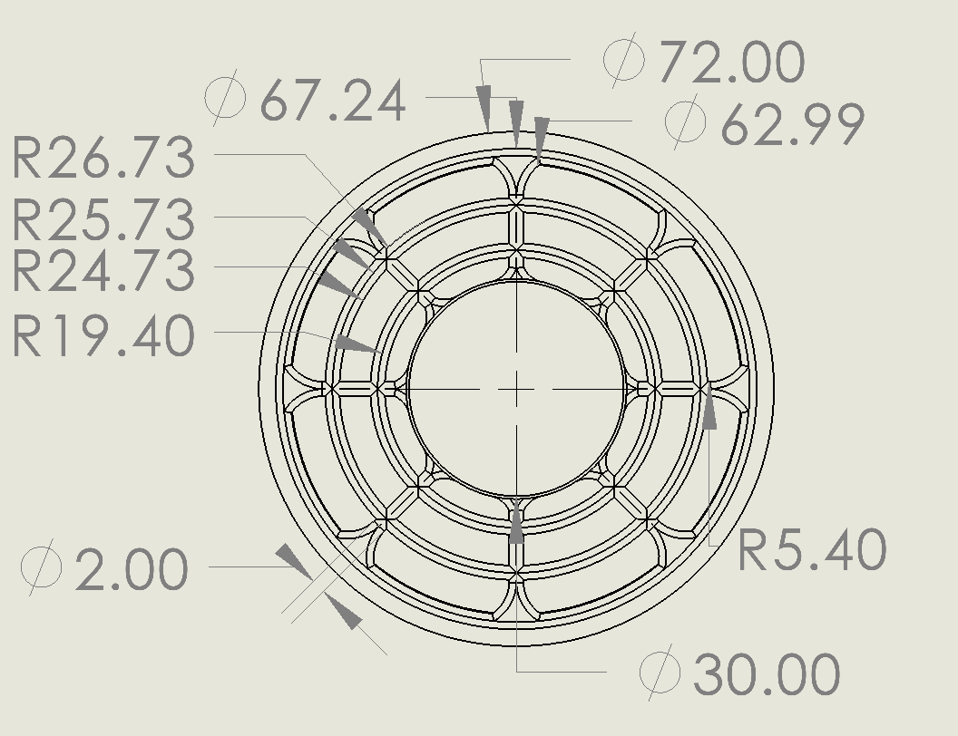
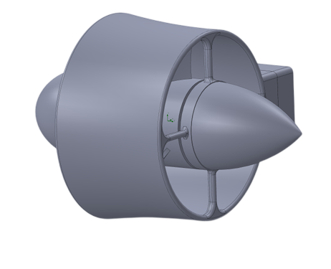
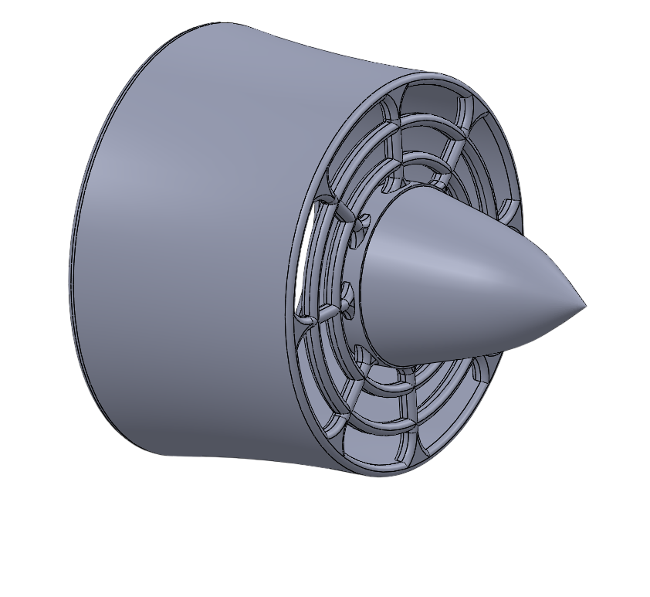
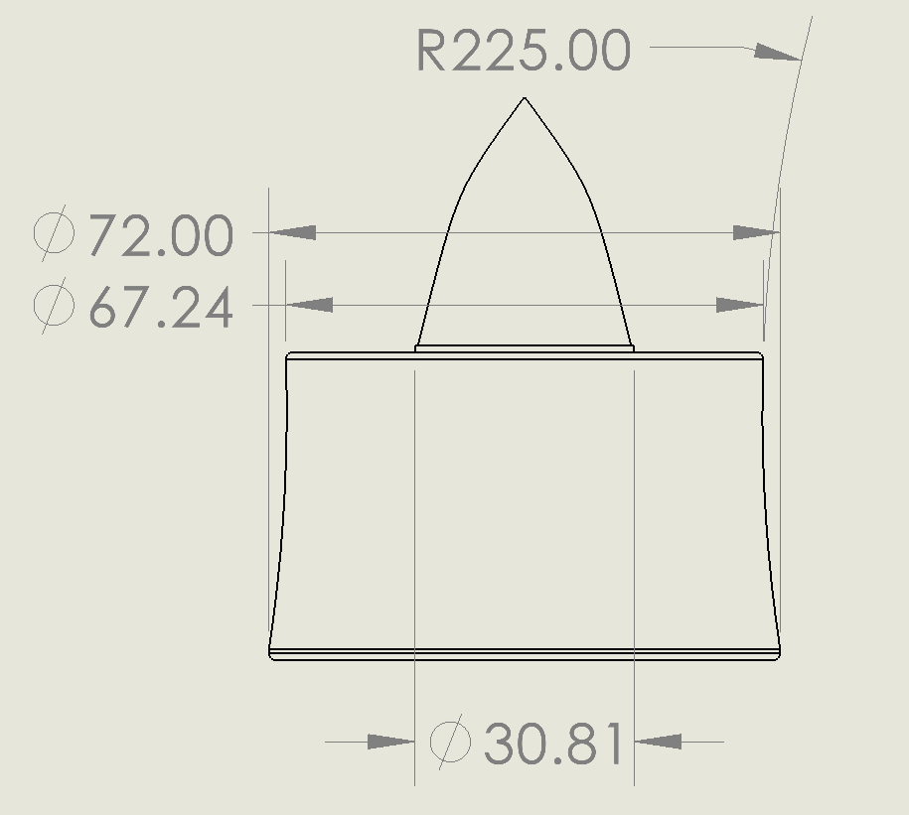
Thruster Guard Specifications
A custom thruster guard mesh will be attached to the default shroud given by manufacturer
Applied Design for Manufacturing (DFM) to model to be compatible with manufacturing methods
2D Model Custom Thruster Guard
Front View (mm)
3D Model of Motor
3D Model Custom Thruster Guard
Top View (mm)
20
Notes:
We will attach a custom mesh to the pre-existing thruster guard that comes with the Diamond Dynamics Thruster kit
Optimized custom mesh to be manufacturable through 3D printing
Mesh will be made of HDPE 3D printing filament

Slide 20

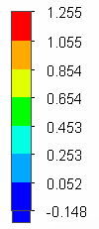

Computational Fluid Dynamics (CFD)
Purpose of CFD is to model Hydrodynamic performance of ROV, this includes:
Coefficient of Drag relative to surfaces of ROV (Sx, Sy, Sz)
Fluid Stability Relative to Reynold’s Number (Defines different velocity values)
Equation for Coefficient of Drag:
Global Meshing feature was used for the mesh of chassis.
Model is relative to surface Sz
(Front & Back of ROV)
Perform component-level optimization
Velocity Relative To Surface (Vz = 1 m/s)
[m/s]
Figure 1: Original Chassis
Figure 2: Rounded Chassis
20
Notes:
Computational Fluid Dynamics (CFD) is meant to simulate hydrodynamic performance of ROV, this includes:
Coefficient of Drag
Fluid stability relative to Reynold’s number
For modeling, global meshing was used for CFD analysis
CFD is performed on component-level optimization
(Example): Coefficient of Drag relative to front surface of chassis decreased by about 16% through component-level optimization

Slide 21
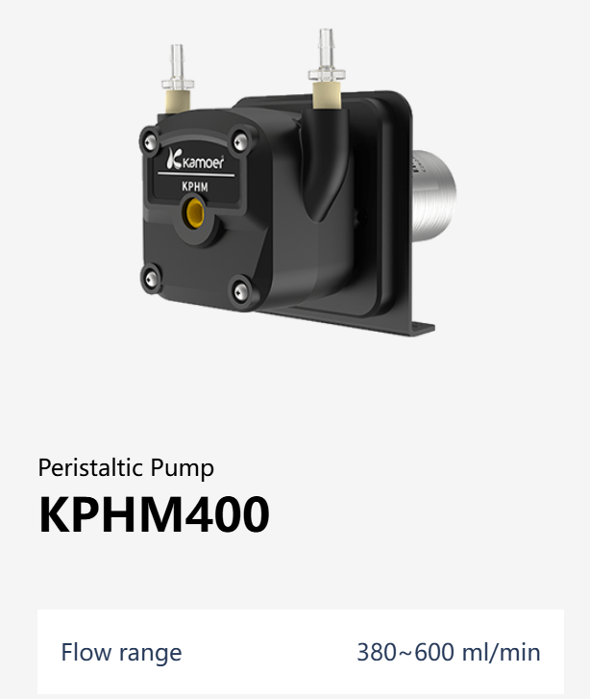
Ballast System - Tank and Buoyant Materials
The ballast system will occupy the top half of the float configuration
A peristaltic pump will be used to pump water in and out of a bladder
The Float will displace a volume of 1L to achieve negative/positive buoyancy
21

Slide 22
Electrical Power Systems (EPS)

Slide 23
Power Budget - ROV & FLOAT
Power Budget - ROV
Subsystem | Number | Voltage (V) | Current (A) | Power (W)
Thrusters | 6 | 12 | 13 | 436.8
Hobby Servo | 4 | 5 | 5 | 100
Raspberry Pi 5 | 1 | 5 | 3.3 | 16.5
BlueRobotics Navigator Flight Controller | 1 | 5 | 0.2 | 1
ArduCam 4k | 1 | 5 | 0.35 | 1.75
Brio 100 | 1 | 5 | 0.35 | 1.75
Pressure/Depth Sensor | 1 | 5 | 0.003 | 0.015
Lights | 4 | 12 | 0.7 | 33.6
Power Budget - FLOAT
Subsystem | Number | Voltage (V) | Current (A) | Power (W)
Ultrasonic Sensor | 1 | 5 | 0.01 | 0.05
Pressure/Depth Sensor | 1 | 5 | 0.003 | 0.015
Pico W | 1 | 3.3 | 0.5 | 1.65
Buoyancy Engine | 1 | 12 | 1 | 12
Heating Pad | 1 | 12 | 0.42 | 5.04
Total Power (W): | 591.415
Power w/ 10% Margin: | 650.5565
Power Supply (V): | 48
Tether Current (A): | 12.32114583
Total Power (W): | 13.715
Power w/ 30% Margin: | 17.8295
Power Supply (V): | 12
Total Current (A): | 1.142916667
25

Slide 24
ROV PCB Implementation
PCB 1 — Front-End + 48→12 + 12 V distribution
48 V input (bulkhead/tether)
Fuse/eFuse (maybe)
TVS surge clamp
EMI filter (common-mode choke + LC)
Contactor/kill (if required)
Mount/connector for the ready-made 48→12 module
12 V bulk capacitors
12 V distribution (fused branches to lights, etc.)
Star ground point + current/voltage sense (optional)
PCB 2 — Control + 12→5 + 5 V distribution
12→5 converter
“Quiet island” filtering (input bead/inductor + caps)
5 V fusing (Pi/USB)
Power supervisor / UVLO for Pi (highly recommended)
Sensor & comms connectors (IMU, pressure, etc.)
Telemetry interfaces (UART/CAN/RS-485)
25

Slide 25
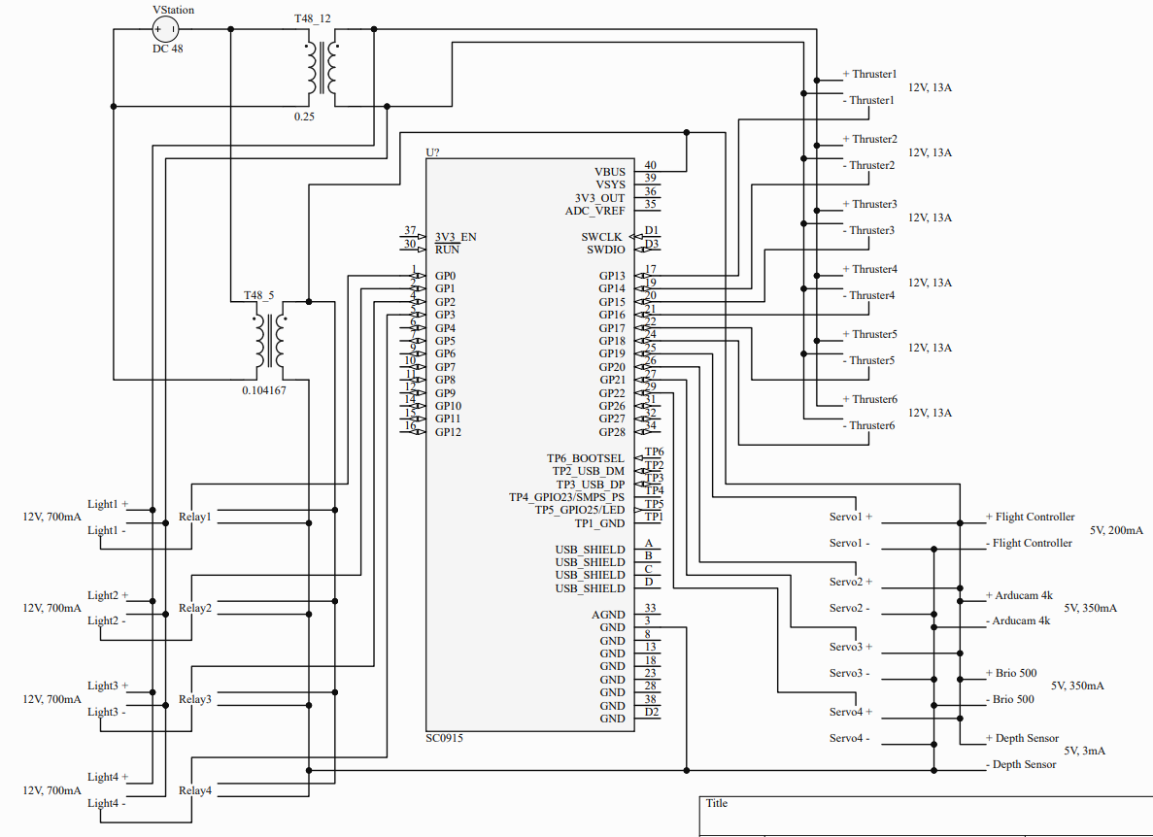
ROV Electrical Schematic
25

Slide 26
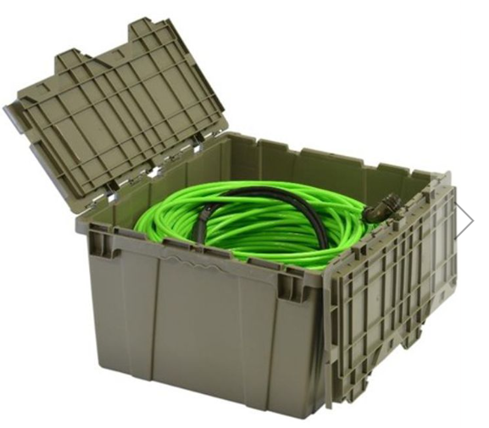
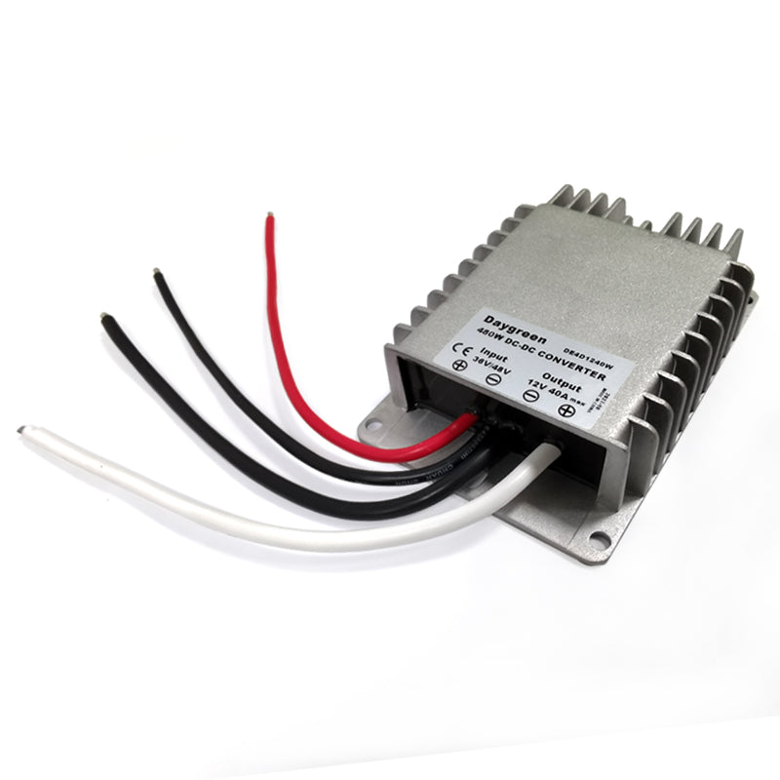
ROV Parts and Accessories
Outland Technology ROV Neutral Cable
Daygreen 48V to 12V 480W DC-DC Step-down Converter
25
Notes:
The tether was selected because It includes a CAT5 line for data, plus a dedicated 22 AWG power conductors. It’s bright color makes it visible underwater as well and simulates the "tether drag" accurately.
However, if the budget doesn’t permit the purchase of this tether, there are workarounds by threading a ethernet cable through a Hollow Braid Polypropylene Rope.
The converter was selected because it can safely handle our estimated 400-watt power demand from six thrusters while maintaining stable voltage under high current and transient loads.

Slide 27
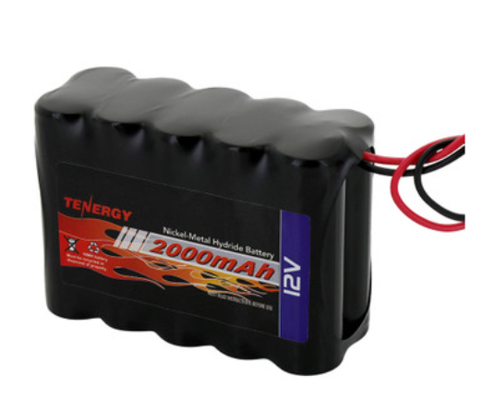
FLOAT Battery
Tenergy NiMH 12V 2000mAh Battery Pack
25

Slide 28
Guidance, Navigation, and Control (GNC)

Slide 29
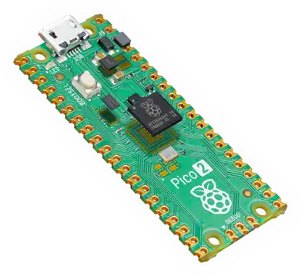
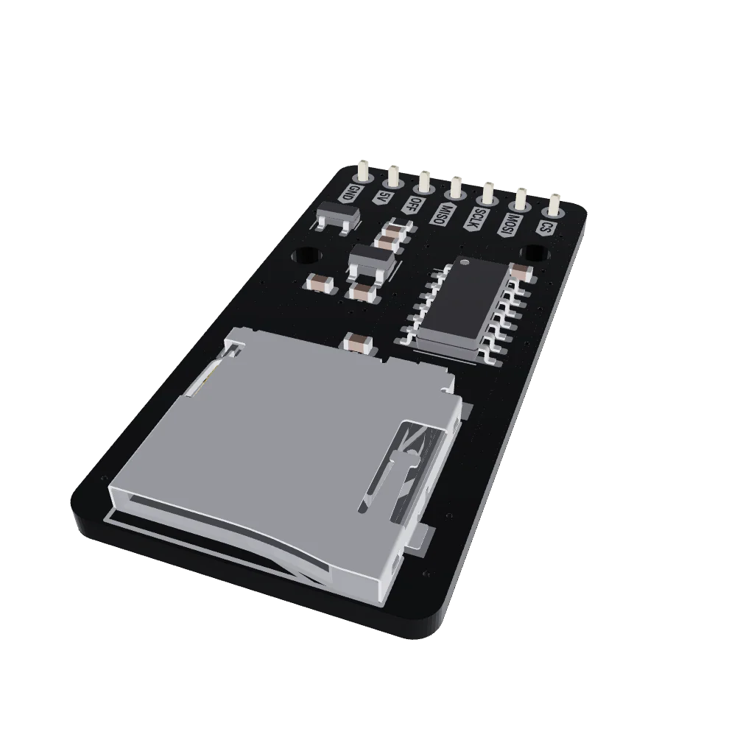
Microcontroller for Float
Built in Wi-Fi 4 and Bluetooth 5.2
MicroPython compatible
Onboard memory + SD card expansion
Pico 2W
27

Slide 30
Concept of Operations
ROV Operations
General Control Strategy
Closed-Loop Stabilization: Implement PID control loops fusing IMU and Depth data for state estimation.
Drift Correction: Active current compensation and "Input Hold" logic to counteract external forces in the Flume tank.
Task 1: Coral Garden (Photogrammetry)
Station-Keeping: Maintain rigid positional fix to minimize motion blur during photogrammetry image capture.
Fine Maneuvering: Low-speed throttle mapping for precise manipulator alignment during species retrieval.
Task 2: Iceberg & Invasive Species
Keel Geometry Mapping: Synchronize high-res depth readings with IMU heading vectors to profile iceberg dimensions.
Multi-Point Hover: Execute distinct hold-position commands at five intervals for stable image recognition of invasive species.
27

Slide 31
Concept of Operations
Float Operations
Autonomous Vertical Profiling
Buoyancy Logic: Microcontroller-driven ballast adjustments based on real-time depth thresholds.
Collision Avoidance: Integration of ultrasonic sensor data to maintain safe standoff distance from ice.
Data Telemetry: Logic trigger to initiate Bluetooth data dump immediately upon surface detection.
27

Slide 32
Computation and Communications (C&C)

Slide 33
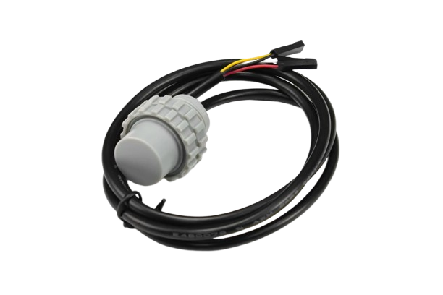
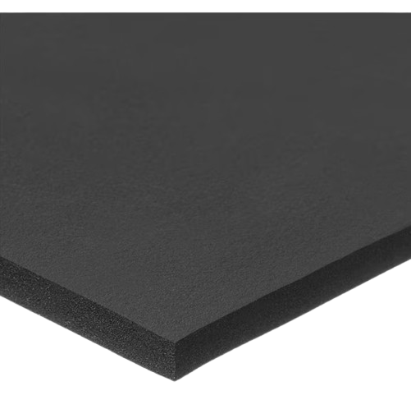
Ultrasonic Sensor with Foam Sheet
IP68 rating
6 meter range
-15°C operating temp, fixed with insulation
32

Slide 34
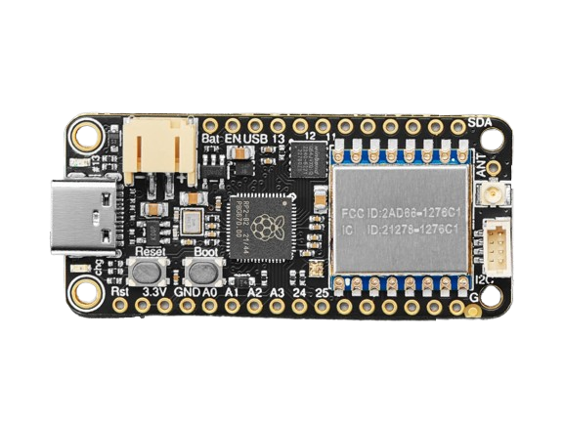
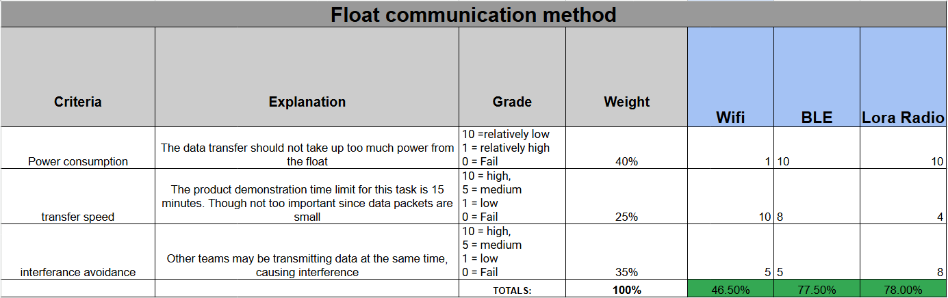
Adafruit Feather RP2040 LoRa Radio
Easily send data packets
Compatible with Raspberry Pi
1.8V~3.7V
34

Slide 35
Q&A
Thank you for your time!

Slide 36
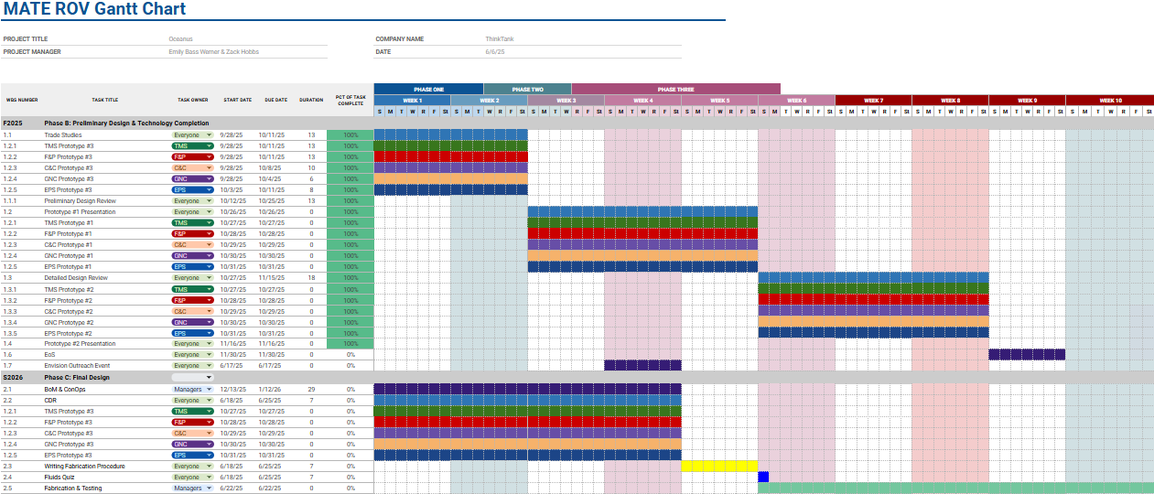
Appendix A: Gantt Chart

Slide 37
Appendix B
Bill of Materials:
Link
GitHub:
Link
3 Environments:
Link
Team Notebook:
Link
Oceanus SOP:
Link

Slide 38
Appendix C
Thermals Library

Slide 39
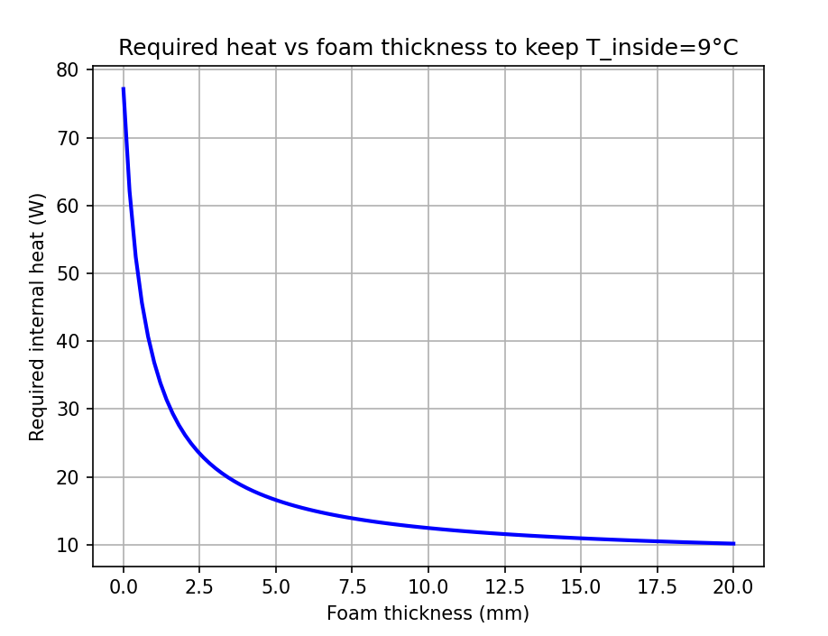
Float Enclosure
Parameters:
-25 C external
9 C target internal
4mm foam
~6mm acrylic thickness
13.75 W electronics
5 W added heat
13.75 + 5 = 18.75 > 18.5 req.

Slide 40
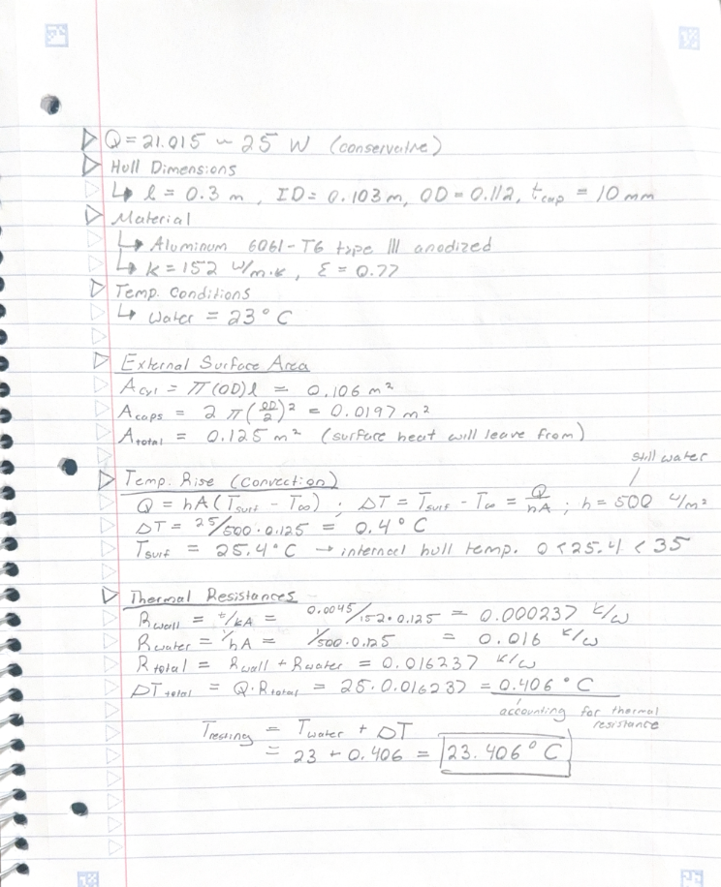
ROV Enclosure
Notes:
25 W accounts for electronics inside enclosure
0.406 C is the calculated temp. rise
23.406 C is the calculated internal resting temp. while submerged

Slide 41
Appendix D
Trade Study Library

Slide 42
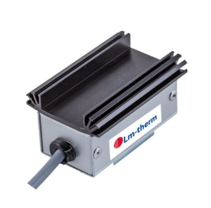
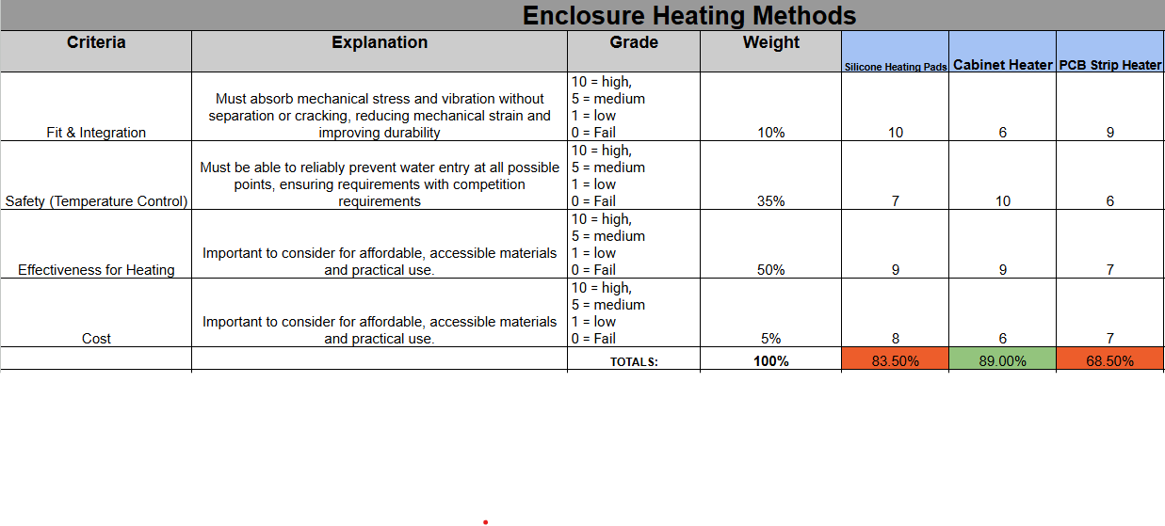
Enclosure Heating Methods
Integrated thermostat
Self regulating temperature to keep above ambient
Anti-condensation
Control Cabinet Heater Super - Mini
10

Slide 43
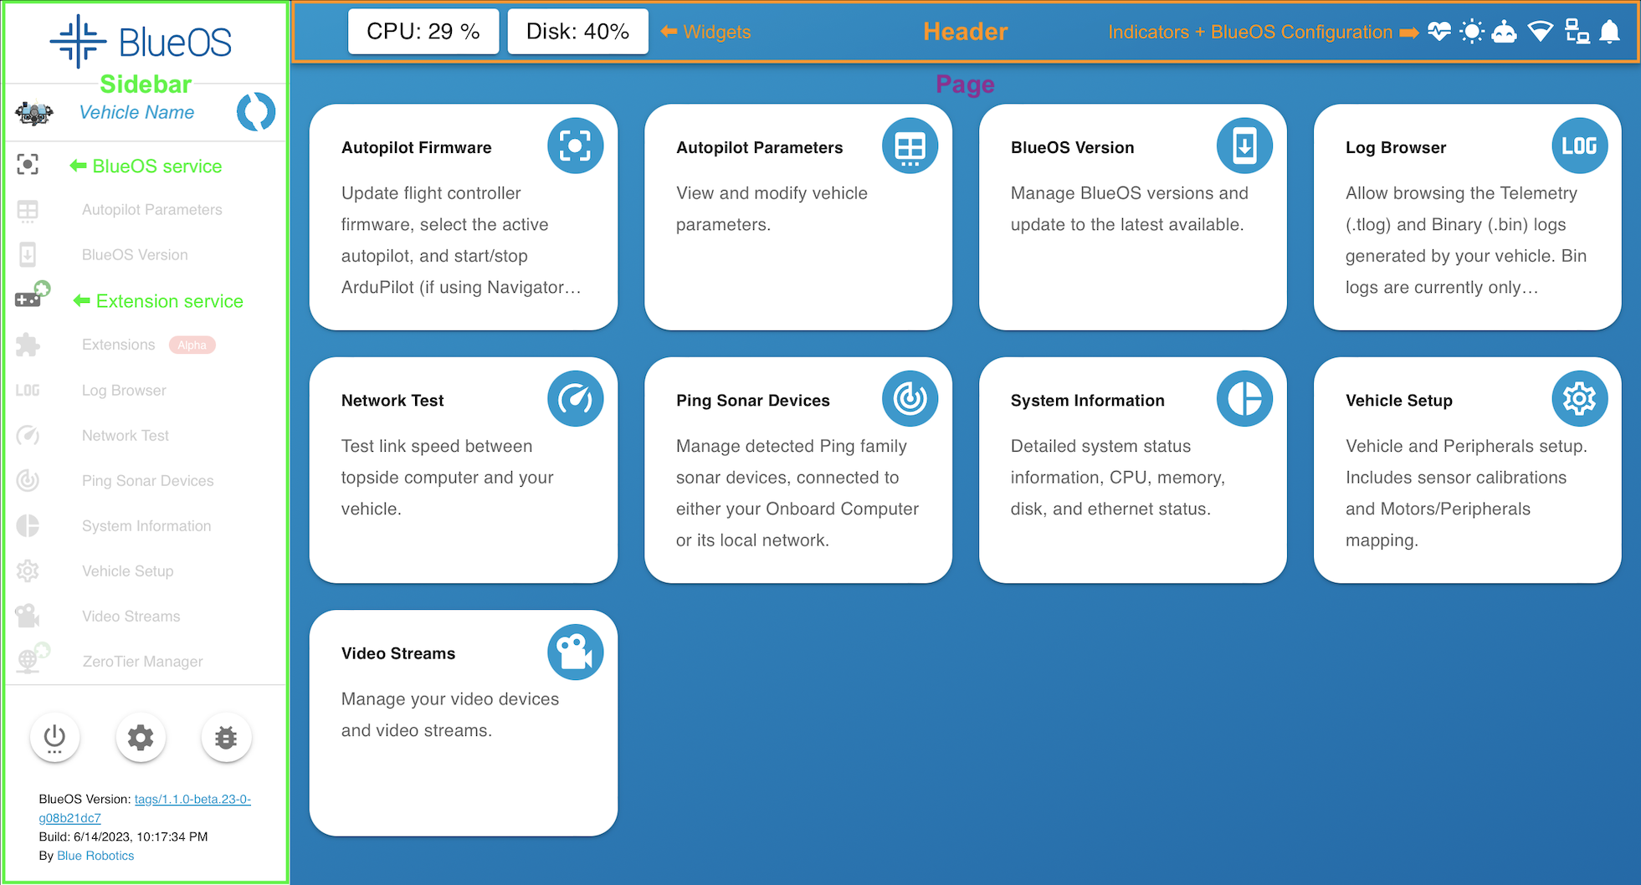

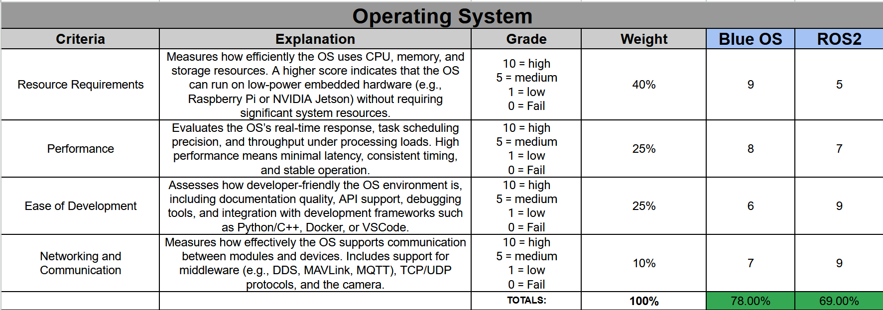
Operating System on ROV
Compatible with our SBC
Python coding
28

Slide 44
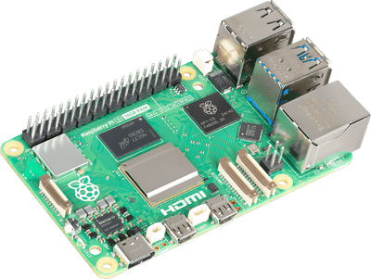
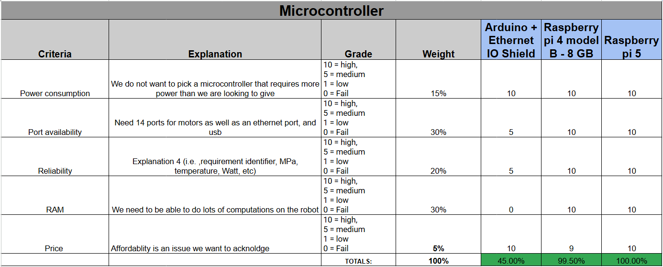
Single Board Computer (SBC)
8 GB RAM
2.4 Ghz CPU
Ethernet (1 Gbps) connectivity
Raspberry Pi 5
27

Slide 45
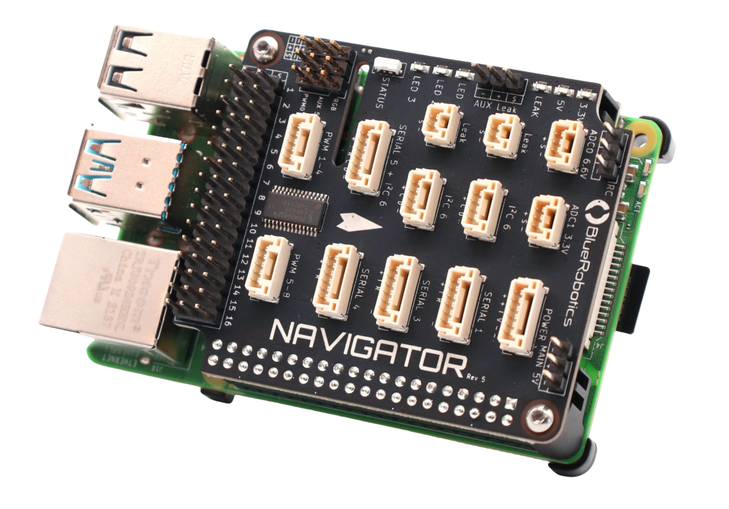
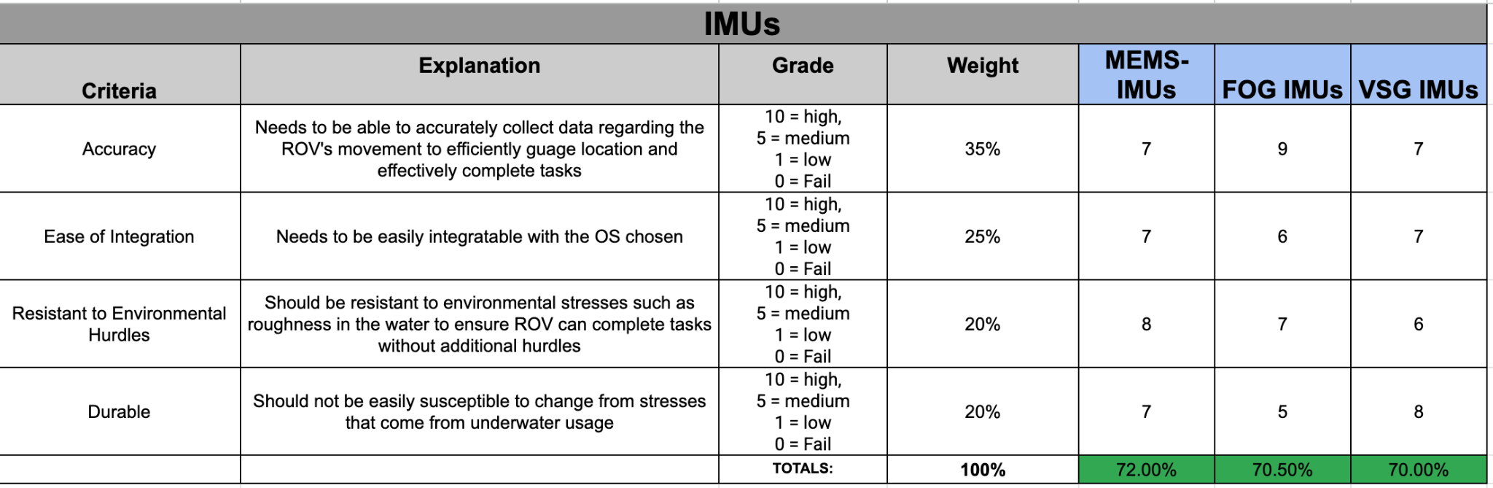
Inertial Measurement Unit
Compatible with BlueOS
Has more than IMU, compass and barometer
6 DOF
BlueRobotics Navigator
29

Slide 46
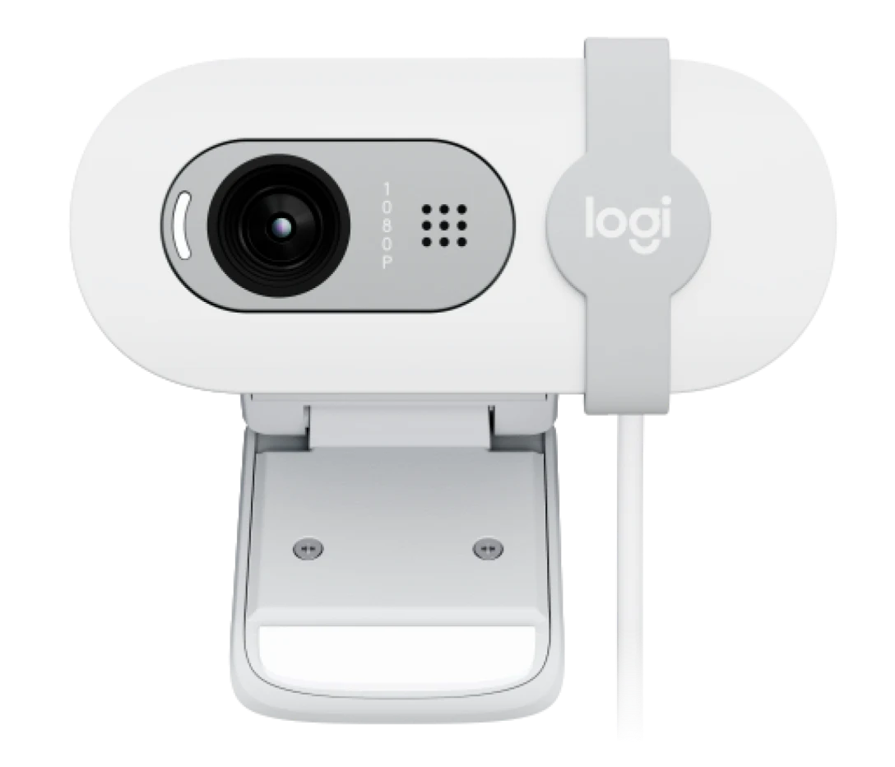
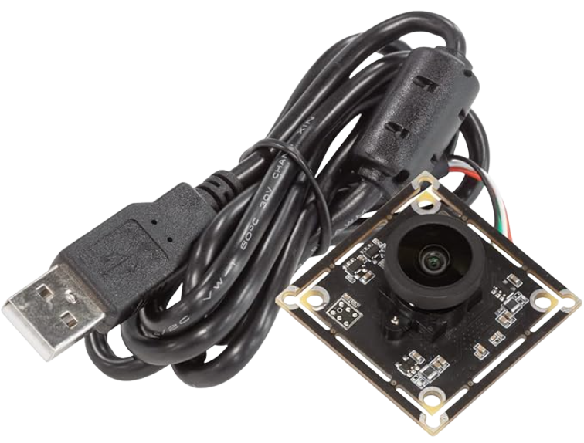
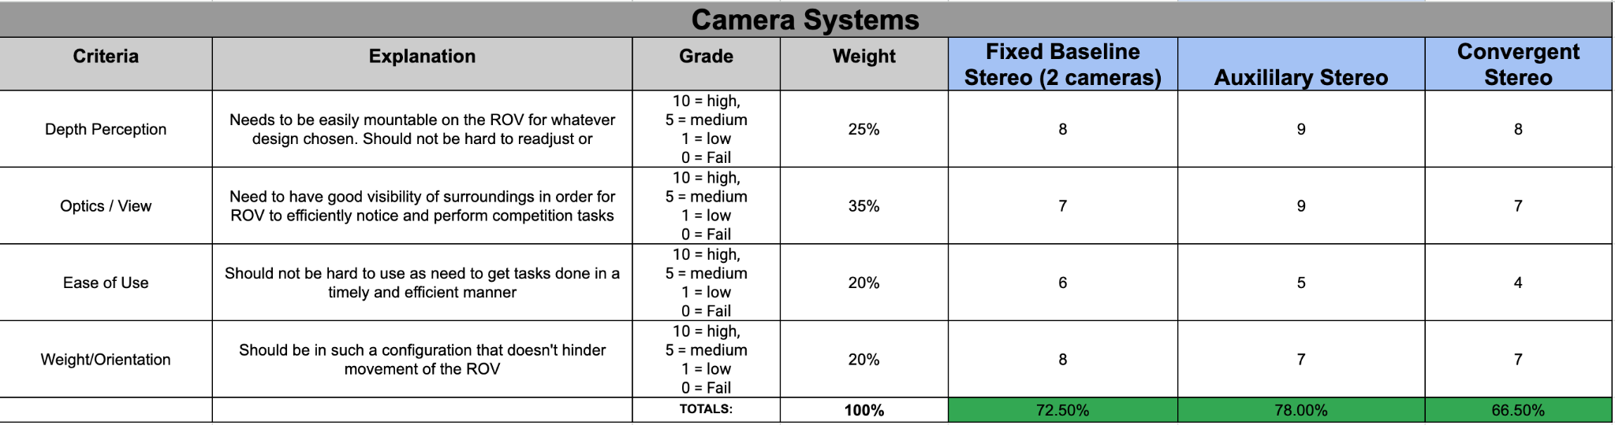
Camera
ArduCam 4K/BRIO 100
One camera (4K) for photogrammetry
12 MP, Max 15 fps, Photo mode
Other camera for video feed
1080p, 60 fps
30
Notes:
Having a dual camera system (auxiliary stereo). most commonly seen for ROVs due to good depth perception and optics. One for general navigation while the other is for more complex tasks like photogrammetry. Brio for general nav and ArduCam for complex tasks. will be connected to rasp pi

Slide 47
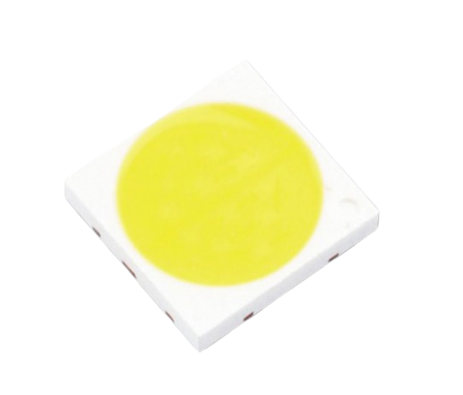
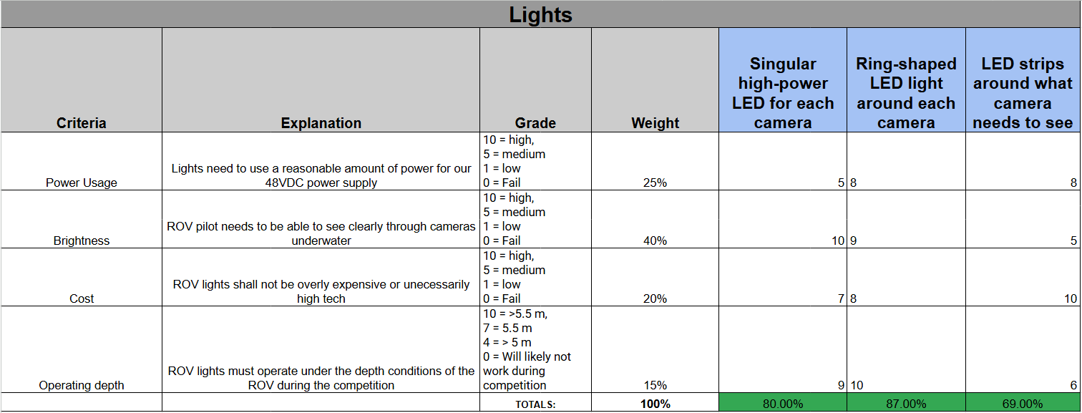
Lights
Diffused LEDs
Each side of camera
1430 lumens
12V
33

Slide 48
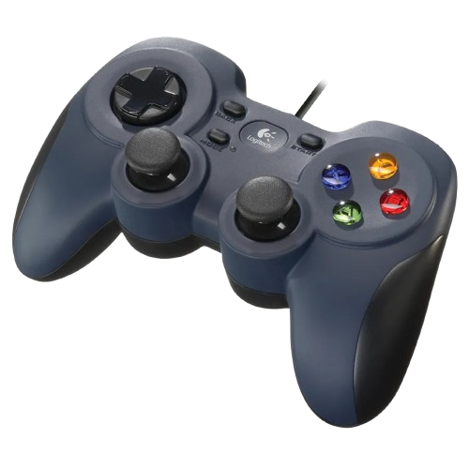

Logitech Controller for C3 Station
Cost-efficient ($15)
Easily programmable
35

Slide 49


Thruster Guard Design
Protruding, concentric mesh 20 mm from motor with IP-20.
Mesh will be made out of HDPE.
HDPE is compatible with Diamond Dynamics Thruster guard shroud.
Mesh has a high tolerance.
Thruster Guard Mesh Material Selection
Thruster Guard Mesh Design Considerations
10

